Slide 1

Index Movement Forecasting via News Sentiment Analysis
Indian Institute of Science
Bengaluru
Project Members:
Brijgopal Bharadwaj
DSBA
brijgopalb@iisc.ac.in
Chandan Rao
DSBA
chandankuma4@iisc.ac.in​
Danish Akhlaq
DSBA
danishakhlaq@iisc.ac.in​​

Slide 2
SCOPE & OBJECTIVE
Analyse news impact on markets.
Prepare an E2E pipeline for assimilating market-news data.
Enhance awareness, forecast markets, support regulation.

Slide 3
PROJECT FLOW

Slide 4
DATA COLLECTION
MODEL 1
URL | content | summary | sentiment
https://www... | With India’s … | six Indian co… | Negative
url | source_url | datetime | authors | title | description | content
https://www... | https://www... | 1733302518 | [‘Ananya Gro… | Stock Market… | The Nifty hit … | The GIFT Nif…
url | urlToImage | source_url | publishedAt | authors | title | description | content | search_query | Source
https://www... | https://www... | https://www... | 2024-10-22 1… | Nikita Prasad | Tata Capital … | This quarter … | Read more … | Tata Motors | Livemint

Slide 5
DATA PRE-PROCESSING
MODEL 1
URL | content | summary | sentiment
https://www... | With India’s … | six Indian co… | -1
url | source_url | datetime | authors | title | description | content
https://www... | https://www... | 2024-10-09 2… | [‘Ananya Gro… | Stock Market… | The Nifty hit … | The GIFT Nif…
url | source_url | publishedAt | authors | title | description | content | companyName | sources
https://www... | https://www... | 2024-10-22 1… | Nikita Prasad | Tata Capital … | This quarter … | Read more … | Tata Motors | Livemint

Slide 6
FEATURE ENGINEERING
MODEL 1
url | source_url | datetime | authors | title | description | content | summary | summary_vader | description_vader
https://ww... | https://ww... | 2024-10-… | [‘Ananya… | Stock Ma… | The Nifty … | The GIFT… | The GIFT … | 0.8979 | -0.7964
url | source_url | publishedAt | authors | title | description | content | companyName | summary | summary_vader | description_vader
https://www... | https://www... | 2024-10-22 1… | Nikita Prasad | Tata Capital … | This quarter … | Read more … | Tata Motors | The earnings … | 0.4939 | 0.5965

Slide 7
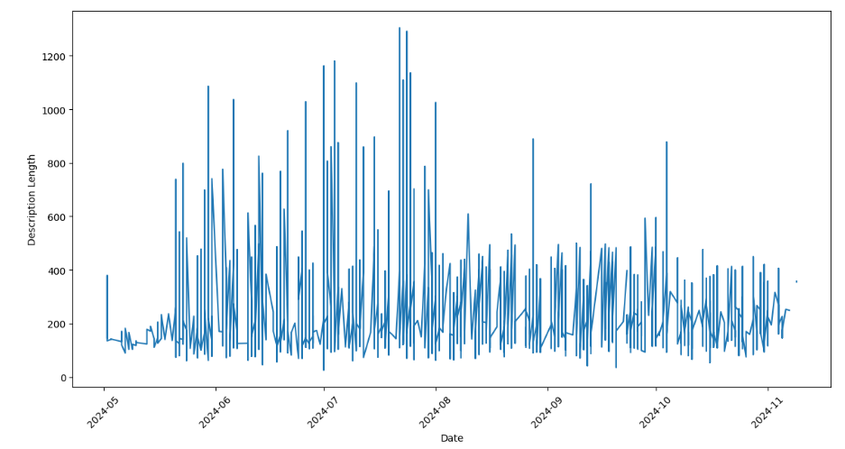
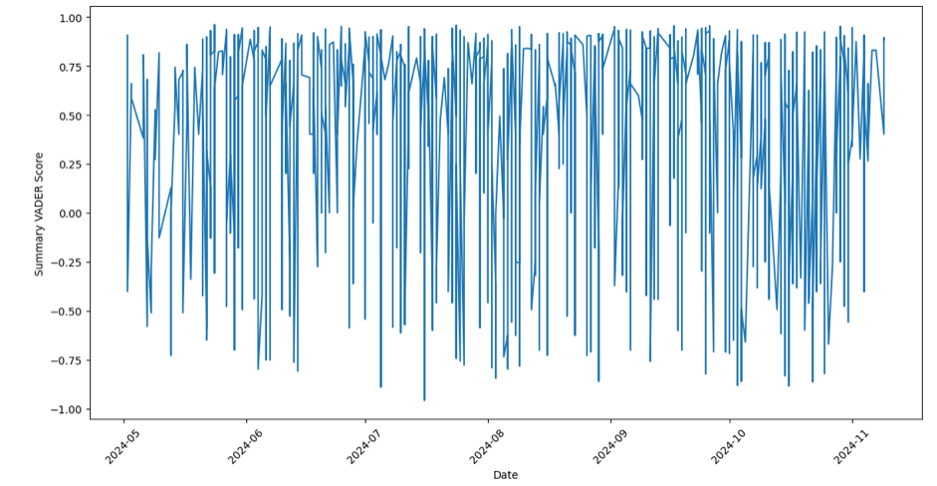
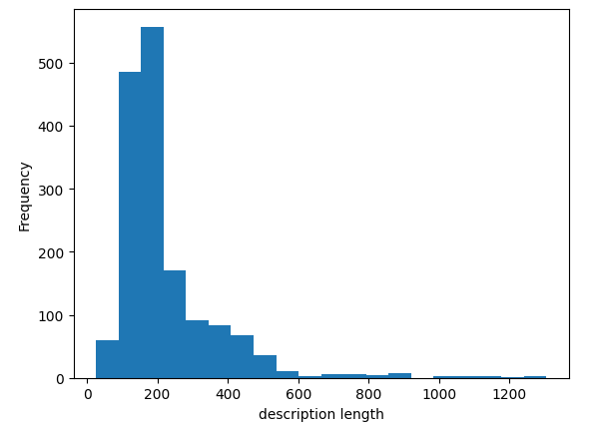
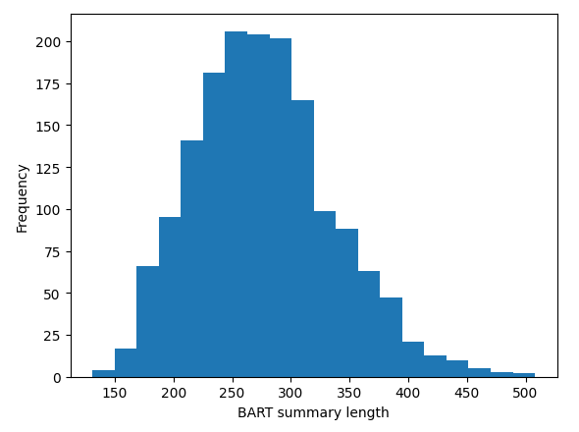
EDA
MODEL 1
Trend in the lengths of article descriptions over time
Trend of sentiment analysis scores (summary_vader) over time
Histogram distribution of the lengths of the text
Histogram of "BART summary length"

Slide 8
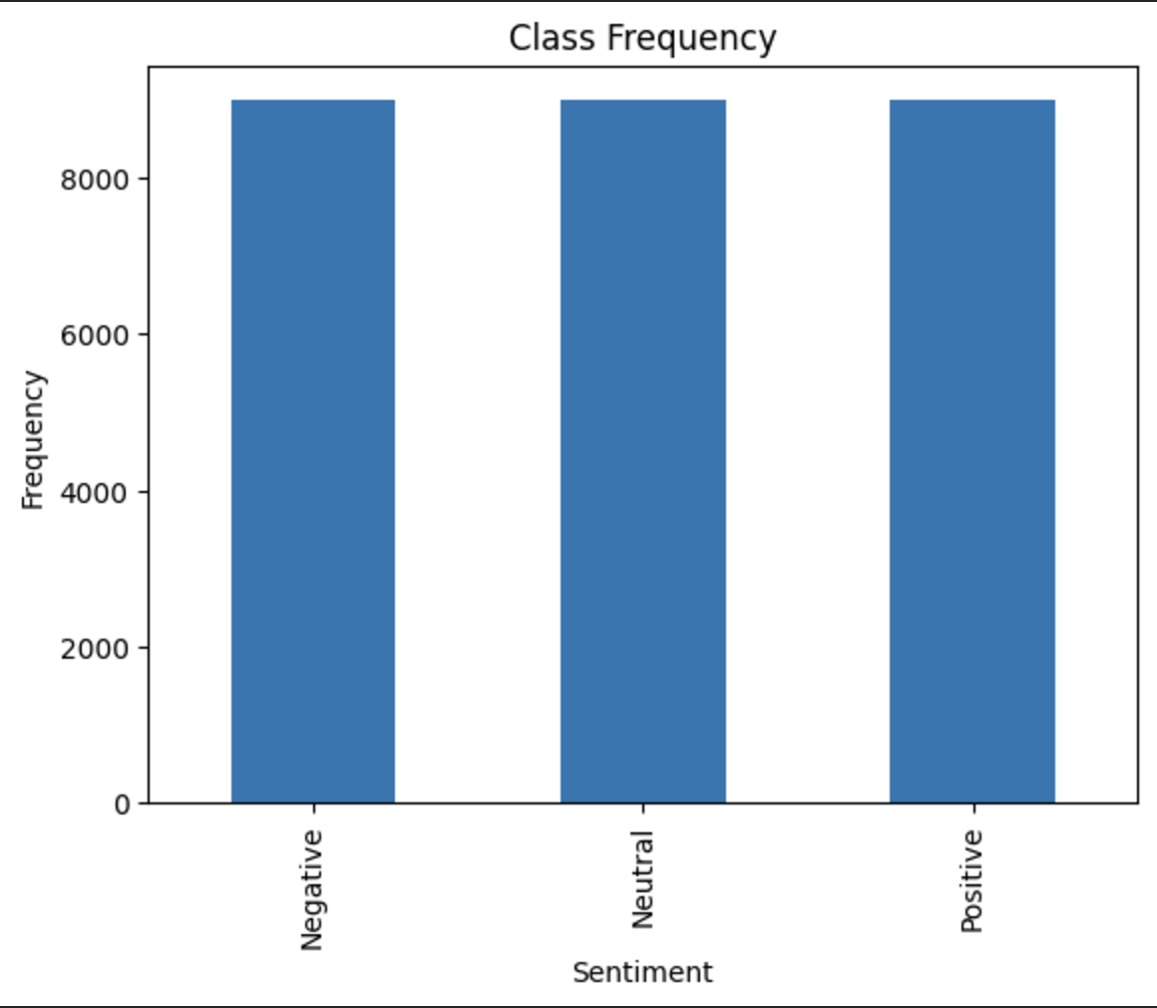
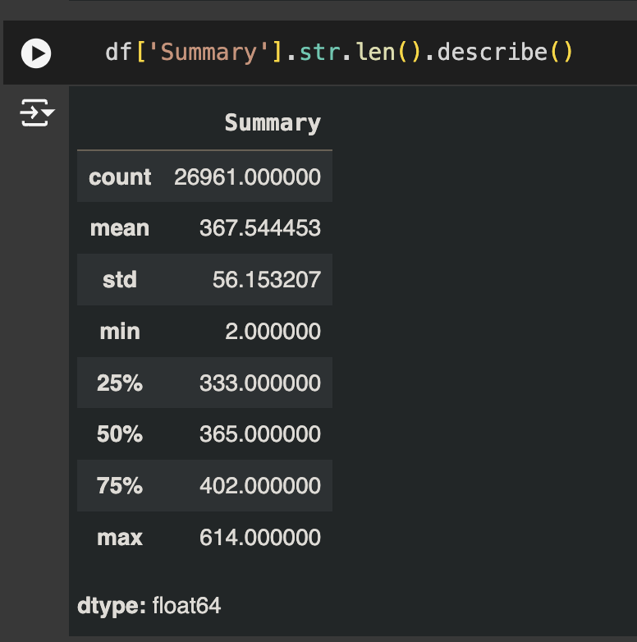
EDA
MODEL 1
Class-frequency Distribution

Slide 9
DATA INTEGRATION
MODEL 1
url | source_url | publishedAt | authors | Company Name | title | description | summary | summary_vader | description_vader
https://www... | https://www... | 2024-06-12 2… | [‘Tripti Sha… | NIFTY | Stock Market… | The Nifty hit … | The GIFT Nif… | -0.4702 | -0.7964
https://www... | https://www... | 2024-10-09 2… | Ananya Gro… | Tata Motors | Ratan Tata’s… | A brief look at the legacy… | In the grand scheme… | 0.8979 | 0.3352
https://www... | https://www... | 2024-08-01 2… | Sumit Nat… | JSW Group | Jindal Steel… | Quarterly Earnings… | On Monday the JSW… | 0.2167 | 0.3419

Slide 10
MODEL1: Market News Sentiment Classification

Slide 11
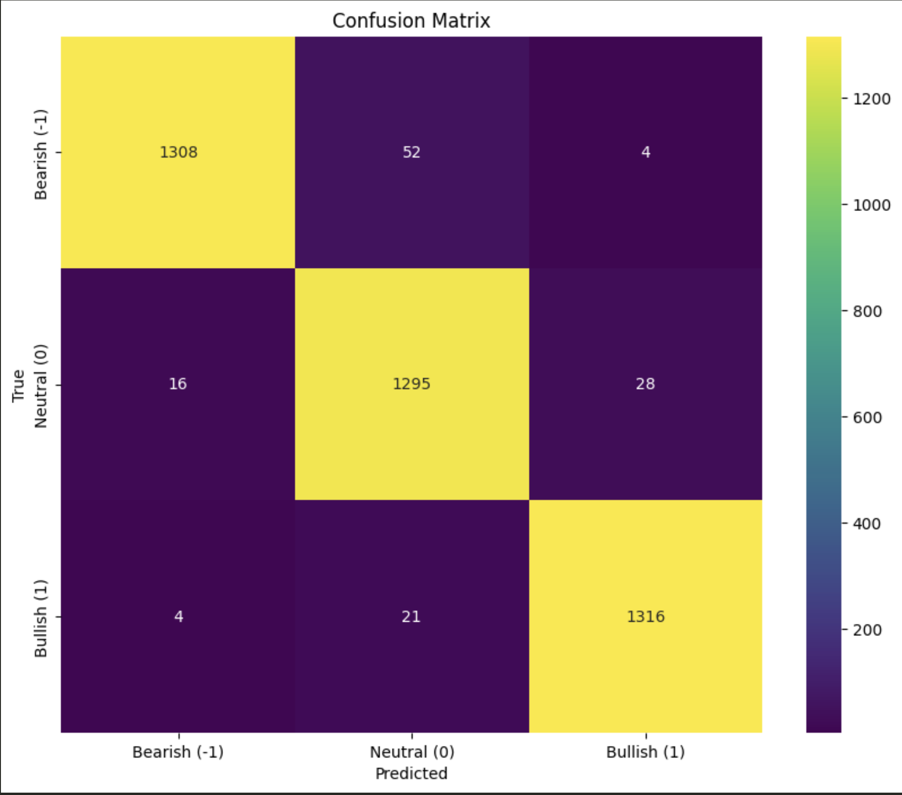
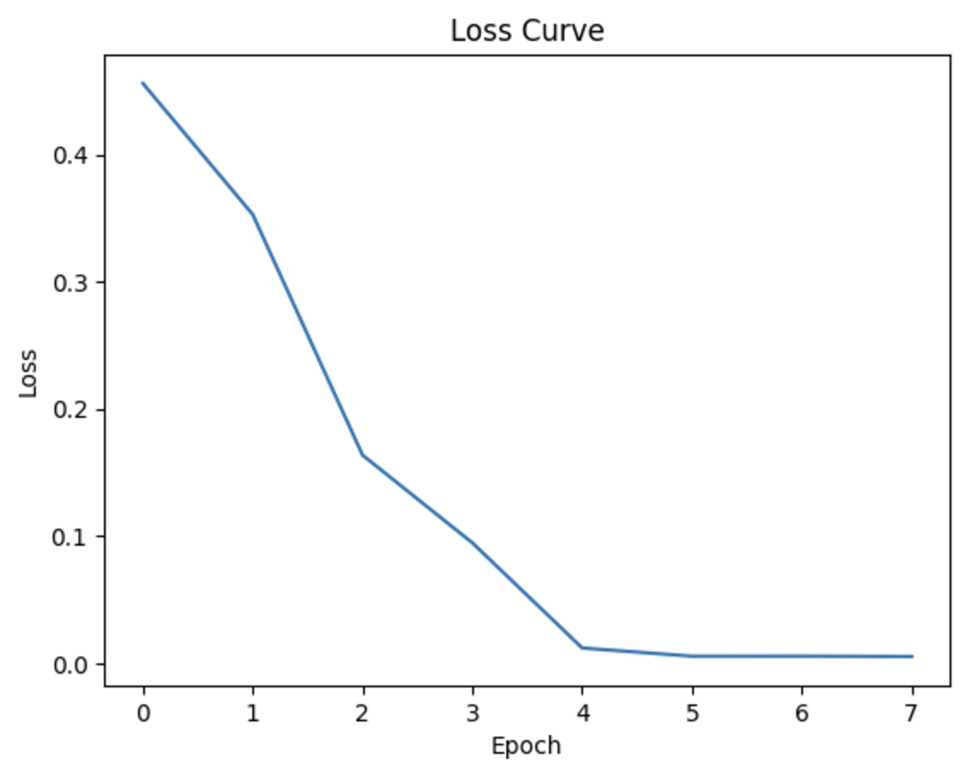
Model 1: EVALUATION
Performance Metrics | Values
Accuracy | 96.91%
Precision | 96.94%
Recall | 96.91%
F1 Score | 96.91%

Slide 12
DATA COLLECTION
MODEL 2
Date | Open | Hgh | Low | Close | Shares Traded | Turnover (₹ Cr)
26-Oct-23 | 19027.25 | 19041.7 | 8837.85 | 18857.25 | 300356469 | 28939.64

Slide 13
DATA PRE-PROCESSING
MODEL 2
Date | Open | Hgh | Low | Close | Shares Traded | Turnover (₹ Cr) | Daily_Chang | Daily_change_percen
26-Oct-23 | 19027.25 | 19041.7 | 8837.85 | 18857.25 | 300356469 | 28939.64 | -170.0 | -0.89345

Slide 14
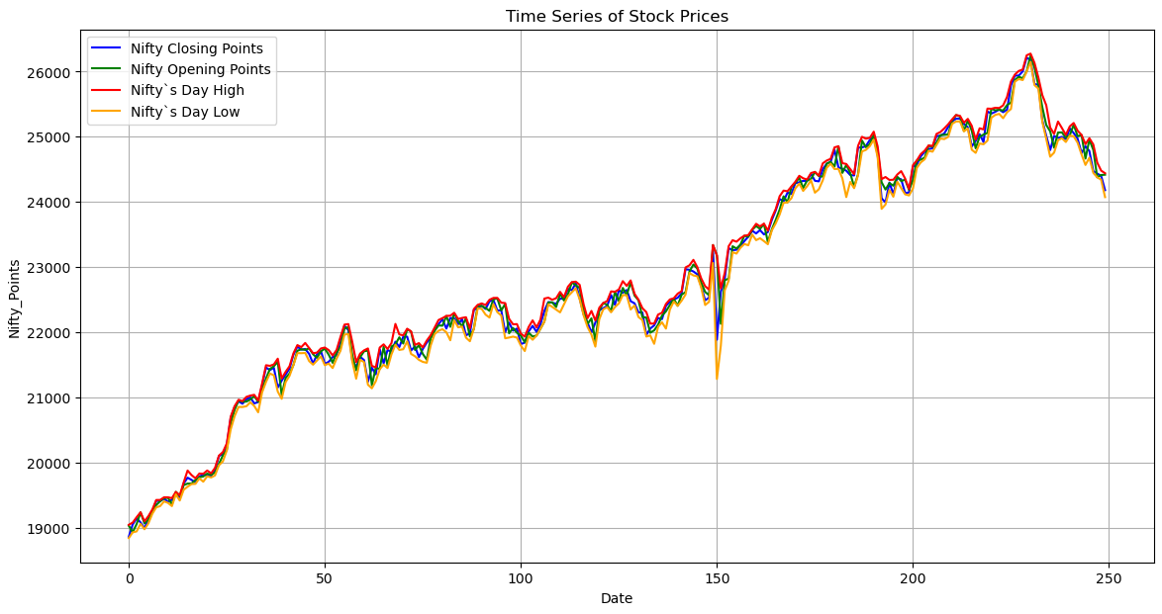
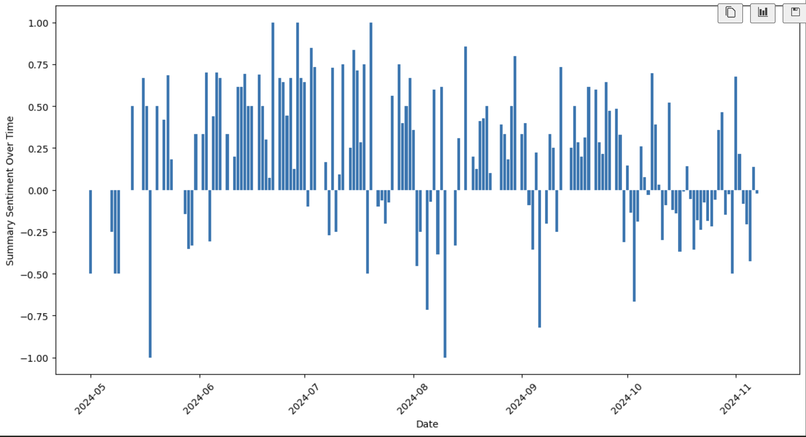
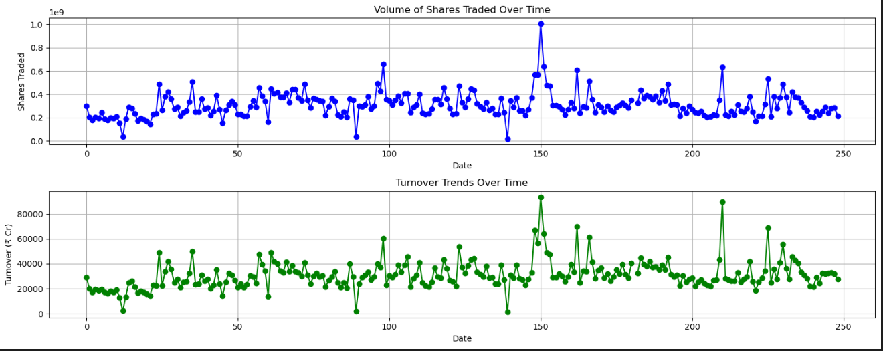
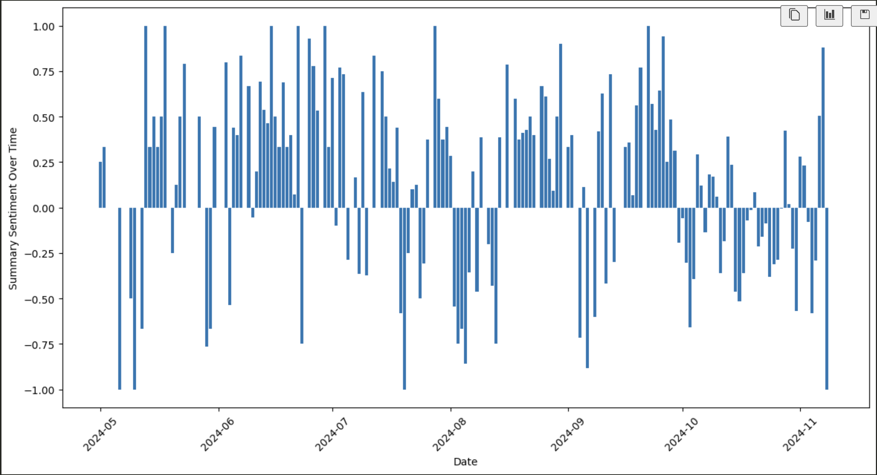
EDA
MODEL 2
Market price movement time series
Summary sentiment overtime
Volume of shares and turnover trends over time

Slide 15
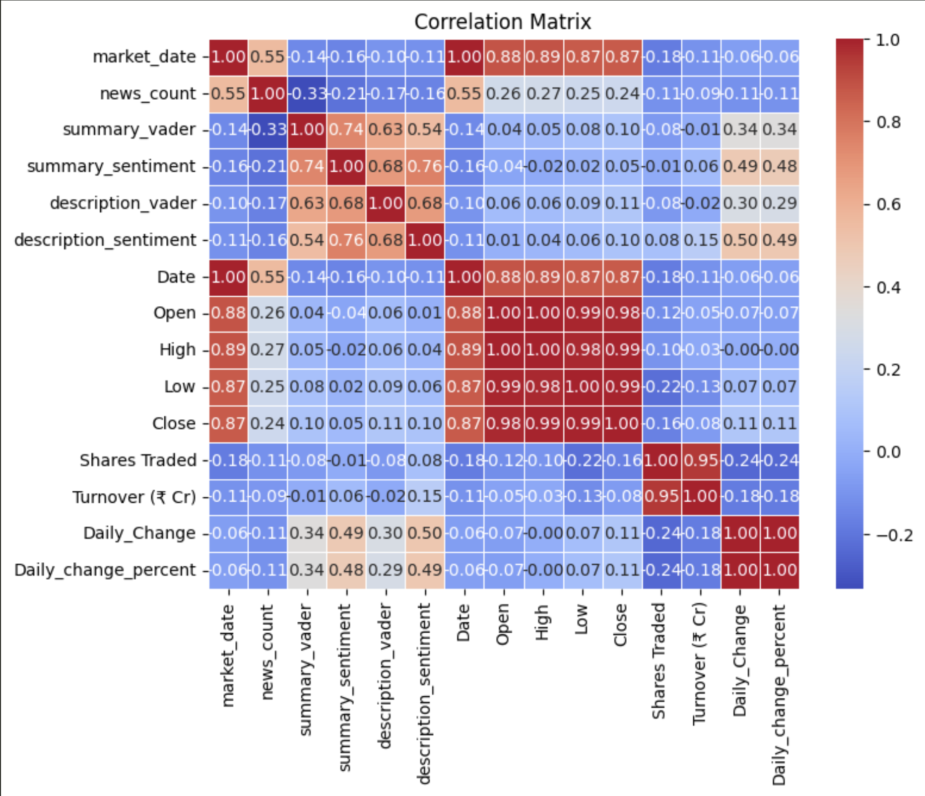
EDA
MODEL 2

Slide 16
FEATURE ENGINEERING
MODEL 2
Market Date | News Count | summary vader | Summary sentiment | Description vader | Description sentiment | Open | High
2024-05-13 | 25 | 0.64265 | 0.333333 | 0.579400 | 0.413600 | 19027.25 | 19041.70
Low | Close | Shares Traded | Daily_ change | Description_sentiment_ rolling_ mean_7 | Description_sentiment_ rolling_ mean_7 | Volume_ rolling_ mean_3 | Volume rolling_ mean_7
18837.85 | 18857.25 | 300356469.0 | 28939.64 | 0.244600 | 0.458307 | 3.16669e+08 | 2.858668e+08

Slide 17
MODEL2: Market-Price Movement Prediction

Slide 18
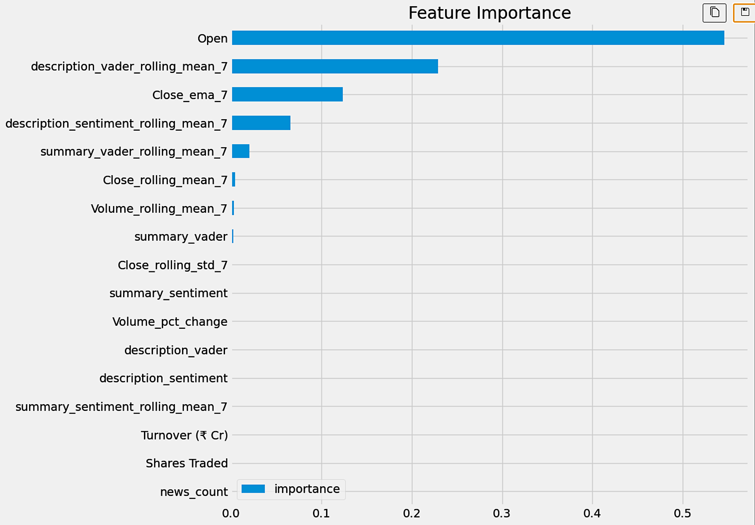
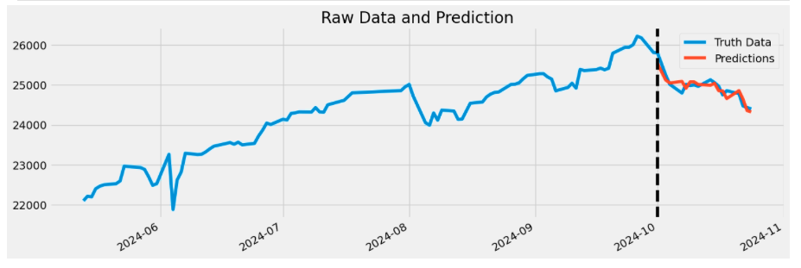
Model 2: EVALUATION
Performance Metrics | Values
Accuracy | 90%
R2 score | 78.35%

Slide 19
Hyperparameter Tunning
Best parameters found: OrderedDict({'colsample_bytree': 0.8, 'learning_rate': 0.05479350229402818, 'max_depth': 3, 'n_estimators': 300, 'subsample': 0.8})
Method: Bayesian optimization,
Optimization for negative mean squared error (neg_mean_squared_error)
15-fold cross-validation.
Best Parameter :
Parameter | value
learning_rate | 0.0547
max_depth | 3
n_estimators | 300

Slide 20
Future Work
Compare BERT performance with other text-embedding models like Word2Vec, etc.
Assimilate dataset for a longer time-window to obtain higher performance.

Slide 21
Data Science Canvas |  |  | Project: | Stock Index movement prediction via news sentiment analysis
 |  |  | Team: | The Trend Trackers
Problem Statement |  |  |  | Execution & Evaluation |  | Data Collection & Preparation
Business Case & Value Added Which business case should be analyzed and what added value does it generate? Perform sentiment analysis on news articles in real-time and use it to forecast an UP / DOWN trend for the indices in near-future. | Model Selection Which analysis methods can be considered based on the specific data landscape and the business case? The sentiment analysis classifier Trend prediction classifier | Model Requirements Which model requirements must be complied with to obtain a valid model? Sentiment score assignment must provide accurate labels to news articles The trend forecasting model must provide trend predictions that are observed within reasonable accuracy bounds in the near-future | Skills What skills are needed to provide the data and model development? NLP embedding assimilation using BERT LLM Real-time data processing Deep Learning Hyperparameter tuning EDA | Model Evaluation Which indicators require quality control and validation and how should they be interpreted? Is real-time monitoring necessary? The model must perform within reasonable accuracy expectations on the market trends being observed in realtime The sentiment scores should match news article content evaluations performed by humans, in majority of the cases | Data Storytelling What requirements does the target group have for the presentation of the results and how do I effectively communicate this data? The summary report for this project will provide models to assign sentiment scores to market news, that can be valuable for the investors & regulatory bodies The market trend forecasting module could find use in algo-trading systems that can leverage this, along with other parameters to achieve higher profits | Data Selection & Cleansing Which of the available data is relevant? Do the data have to be cleaned up? The sentiment score datasets and realtime news API appear to be relavant The datasets being employed need pre-processing and cleanup for training process The realtime data might need sanity check to be usable in our system | Data Collection How and with which methods should additionally required data be collected? What properties has this data to fulfil? NA
Data Landscape Which data is required for this, and which is already available? Which additional data has to be collected? Stock index prices News articles via API BERT embeddings Historic labeled dataset for sentiment analysis of news articles |  | Software & Libraries Which software should be used? Is there already a standard solution? Which libraries are used? No standard solution Sklearn Transformers (Huggingface) API requests |  |  |  | Data Integration In which system should the data from different sources be migrated? All data processing will be done using python sciprts For data migration, formats like CSV or JSON would be employed. | Explorative Data Analysis Are there outliers or structures to be considered? Creation of descriptive key figures for the first assessment of the data. To be determined once EDA begins

